Slide 1

Incident Response and everything else for good measure….
Aarhus business academy – 19/09/2019
David Thejl-Clayton

Slide 2

A little about me
British but starting to feel more and more like a Dane...
Yeah yeah, one day I will speak Danish to you all...
Lived in Denmark 4.5 years, with my wife and 2 kids..
Incident Response Lead/SOC Lead/SOC Architect/CTI/Whatever else is needed…
I love open source security solutions, I run the Security Distractions blog…
I also maintain ElastiMISPStash alongside Dennis Lund Christiensen…

Slide 3
Introduction
Today we will talk about the following stuff:-
Processes – CSIRT Services Framework 2.0
Frameworks – Cyber Kill Chain, NIST IR, MITRE
Tools – MISP, ELK stack, ElastAlert, The Hive, elastimispstash…

Slide 4
Why do we do incident response?
The Center for Cyber Security (CFCS) yearly statement:-
Truslen fra cyberspionage er MEGET HØJ.
Truslen fra cyberkriminalitet er MEGET HØJ.
Truslen fra cyberaktivisme er MIDDEL.
https://fe-ddis.dk/cfcs/publikationer/Documents/Cybertruslen-mod-Danmark-2019.pdf

Slide 5
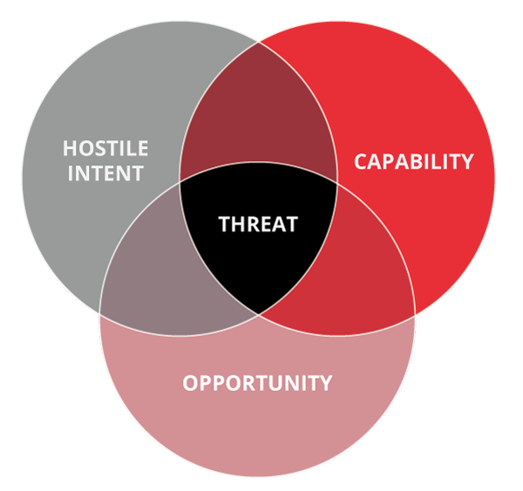
But what is a threat?
Intent: Do they have reasons to target you? Competitor?
Capability: Do they have the tooling and skills to carry it through?
Opportunity: Will they get the opening they need?

Slide 6

Opportunity
Opportunity is within the organizations influence:
Public facing vulnerabilities
Technical or design flaws (architecture)
User awareness
NIST IR Preparation stage

Slide 7
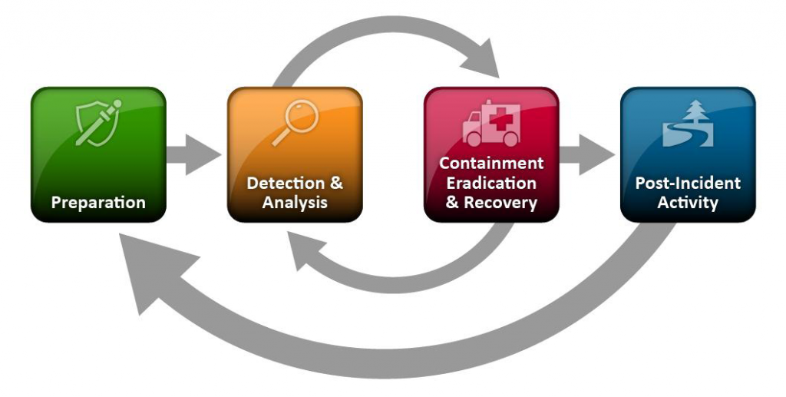
NIST IR Lifecycle/model/framework/whatever...
https://nvlpubs.nist.gov/nistpubs/SpecialPublications/NIST.SP.800-61r2.pdf

Slide 8

FIRST – CSIRT Services framework
FIRST = Forum of Incident Responders and Security Teams
Bible for running incident response
Service Areas:
Information Security Event Management (Detection)
Information Security Incident Management (CSIRT)
Vulnerability Management
Situational Awareness
Knowledge Transfer
https://www.first.org/education/csirt_services_framework_v2.0

Slide 9
So we know what we need to do, but how to do it?
Stage 1
Alert
Stage 2
Reciept
Stage 3
Analysis
Stage 4
Response
Stage 5
Reporting
Acknowledge
RFI
Response actions
Communication

Slide 10
Stage 1 - Alert
Alerts could be classified as “events”, simply put how do events get into your CSIRT team?
Detection’s
Constituents
CSIRT’s External – RFC 2350 - https://www.ietf.org/rfc/rfc2350.txt
https://www.cert.dk/en/About_DKCERT/RFC2350

Slide 11

Alert – Requirements?
The CSIRT will need some basic information from the reporter or alert to help classify and prioritize the event….
Do not reinvent the wheel!
Look to frameworks:
VERIS
STIX

Slide 12
VERIS
Vocabulary for event recording and incident sharing
Common language to describe an incident….
http://veriscommunity.net/

Slide 13
Alert fatigue
Writing detections is fun….. But remember to think of your CSIRT team….
Number of alerts per day?
Number of people on shift?
Profit

Slide 14
Quick detour
Detection rules need to be built on top of something right?

Slide 15
Logging logging logging
Storage
Ship
Normalize
Enrich
Transport
Query/Visualize
Log Sources
Detection
Schema

Slide 16

ElK Stack
Made up of the following components:-
Filebeat – Log shipper
Logstash – Parsing logs, transforming and transporting them
Elasticsearch – Indexing and storing of data
Kibana – Displaying data from Elasticsearch and querying it
Indexes on ingestion (sales sales sales)

Slide 17
ElasticSearch
Storage
Filebeat
Logstash
Kibana
Ship
Normalize
Enrich
Transport
Query/Visualize
Log Sources
Detection
Schema

Slide 18
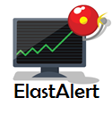
Elastalert
Developed by YELP…
Utilizes Elastic search API…
Built in Python…
Rules are built in YAML…
Modular rule design…
Monitor, Pattern, Alerter...
{
name: MISP-Alerter type: any index: sd-* filter: - query: query_string: query: "misp.tags: Feed-Alert"
alert: hivealerter” }

Slide 19
ELAstalert – Even more goodness
Plenty of Rule types
Any, Blacklist, Whitelist, Spike, etc etc
Alerters
Slack, MS Teams, The Hive, HTTP POST, etc etc
Sigma rule translator...

Slide 20

SIGMA
Different SIEM vendors/alerting products, have different schemas for building rules…
Generic language/Framework – DO NOT REINVENT THE WHEEL!
Open source translators
Elastalert - https://github.com/Neo23x0/sigma/blob/master/contrib/sigma2elastalert.py

Slide 21
Ok where were we?
Stage 2……

Slide 22
Stage 2 - Reciept
Stage 1
Alert
Stage 2
Reciept
Stage 3
Analysis
Stage 4
Response
Stage 5
Reporting
Acknowledge
RFI
Response actions
Communication

Slide 23
Stage 2 - Receipt
Initial triage
Reject false positives
Accept true positives
Correlate – Overlapping Asset? IOC? Command?
Apply categorization
VERIS
Apply prioritization?

Slide 24
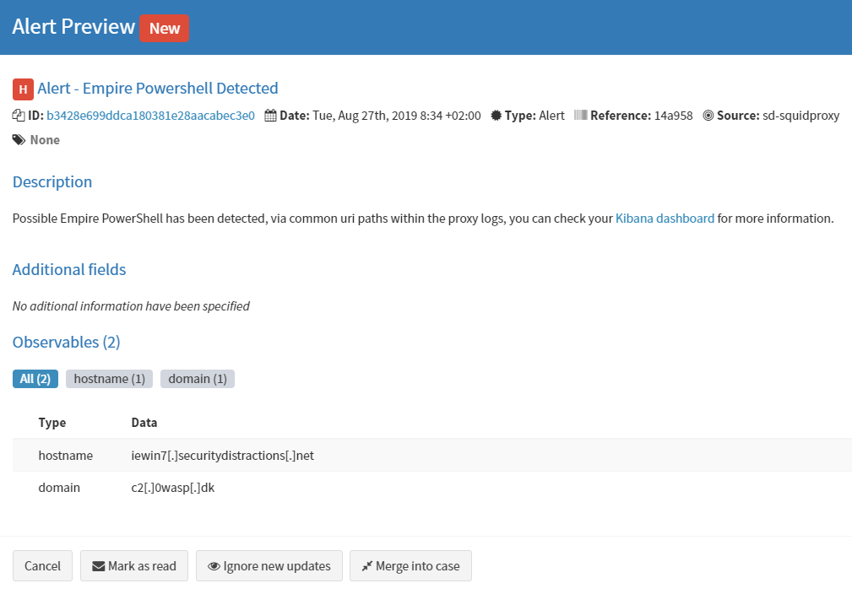

Slide 25

The Hive
Incident response case management tool...
Works with the concept of ”alerts” and ”cases” and ”observables”.
Observables (indicators) can be correlated based on:-
Previous cases…
Incoming alerts…
You can map your playbooks in as case templates…

Slide 26
Stage 2 – Receipt – Comms and contain
Communication with your constituent is key here:-
Acknowledge – If alert has come from them
Inform – If an alert has come from detection
Containment options (CSIRT Mandate)
Block IOC’s / Observables
Kill machines connections
Lock out users

Slide 27
And one more Slight detour - Containment
Courses of action……

Slide 28
Courses of action
Discover – You gained an indicator, go search your logs for history of it
Detect – You gained an indicator, lets write a detection rule
Deny – Creating a firewall block rule, proxy filter, AV hash filter etc
Disrupt – Makes the event fail as it is occuring, example could be IPS
Degrade – Slow down the intrusion in progress, could be via bandwith throttling

Slide 29
Courses of action – Continued
Decieve – Make the intruder think the attack is successful, forwarding traffic towards a honeypot
Destroy – Offensive action against the intruder, arrest, physical destruction of property, hacking back (don’t do this)….!

Slide 30
Ok where were we?
Stage 2……

Slide 31
Stage 3 - Analysis
Stage 1
Alert
Stage 2
Reciept
Stage 3
Analysis
Stage 4
Response
Stage 5
Reporting
Acknowledge
RFI
Response actions
Communication

Slide 32
Stage 3 - Analysis
Information collection:-
Gather artifacts – Binaries, memory images
Gather observables – URL’s, domain’s, checksums, IP’s etc
Initial analysis:-
Comparison with well known public and private repos for threat data
MISP – Public and private sharing
VirusTotal, domain tools etc.

Slide 33

MISP – Malware information sharing platform
Threat Intelligence Sharing Platform
Not just threat data!!
Developed by CIRCL in Luxembourg
Originally a NATO project…
MISP API
Used for automating lots of interesting things…

Slide 34
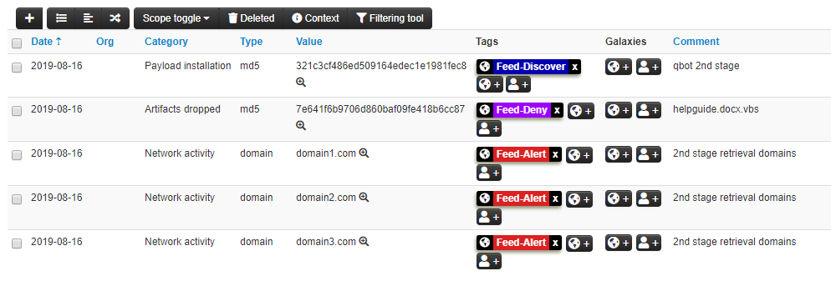
MISP - Example

Slide 35



MISP – Courses of action...
Feed-Discover
Go and out find this indicator in the entire log estate...
Feed-Alert (Detect)
Feed-Deny
API
Discover
Deny
Detect

Slide 36
Stage 3 – AnALYSIS – Comms and Contain
Communication with your constituent is key here:-
Do I need more info from them? E.g. Original phishing mail?
RFI Process
Inform – Update on case progress – Depending on priority
Containment options (CSIRT Mandate)
Block IOC’s / Observables
Kill machines connections
Lock out users

Slide 37
Stage 3.1 – Further Analysis
Observables are subjected to heavier analysis:-
Sandboxing
Static analysis – Memory analysis etc
Reverse engineering
Request for assistance – Other CSIRT

Slide 38

GRR - Google rapid response
Built in python
Agents installed on endpoints
Used for gathering forensic data
Obtaining current network configuration
Retrieving artifacts for further analysis

Slide 39
Stage 4 - Response
Stage 1
Alert
Stage 2
Reciept
Stage 3
Analysis
Stage 4
Response
Stage 5
Reporting
Acknowledge
RFI
Response actions
Communication

Slide 40
Stage 4 - Response
Based on input from analysis stages and combined with impact and priority, the CSIRT will communicate with their constituent and decide on a response plan to activate:-
Containment actions
Recovery actions:-
Reimage endpoints
Rebuild services
Rebuild AD?!?!

Slide 41
Stage 5 - Reporting
Stage 1
Alert
Stage 2
Reciept
Stage 3
Analysis
Stage 4
Response
Stage 5
Reporting
Acknowledge
RFI
Response actions
Communication

Slide 42
Stage 5 - Reporting
After the response plan is carried out… The CSIRT’s role is not over…
Now we must report:-
Containment actions taken by CSIRT
Incident recording – VERIS
Lessons learned

Slide 43
Stage 5 – Reporting

Slide 44
Stage 5 – Reporting – Lessons Learned
The CSIRT normally gets to see quite a lot of interesting holes and design flaws…
Root cause analysis
How can we help improve things?
Architectural improvements
Improve processes – E.g. vulnerability handling

Slide 45
Stage 5 - Reporting
Management question: “CSIRT, how many times were we hit by Ransomware last year?”
Or
“How many times have we seen Exim exploited in our DMZ?”
Metrics, metrics, metrics - VERIS

Slide 46
MITRE ATT&CK vs Kill Chain
Ongoing debate in some circles:-
MITRE – Great at describing techniques and locking you into specific attack types, downside is it is very much a post exploitation framework
Kill Chain – Room for your own interpretation, can be used to describe complex intrusions by chaining multiple kill chains together

Slide 47

MITRE Att&ck
Can be used for:-
Intrusion analysis and reporting
Building detections
Judging detection capabilities and maturity
Threat Intelligence

Slide 48
Mitre Att&ck Navigator
https://mitre-attack.github.io/attack-navigator/enterprise/

Slide 49
MITRE ATT&CK
Detection capability and maturity:-
https://cyberwardog.blogspot.com/2017/12/ready-to-hunt-first-show-me-your-data.html

Slide 50
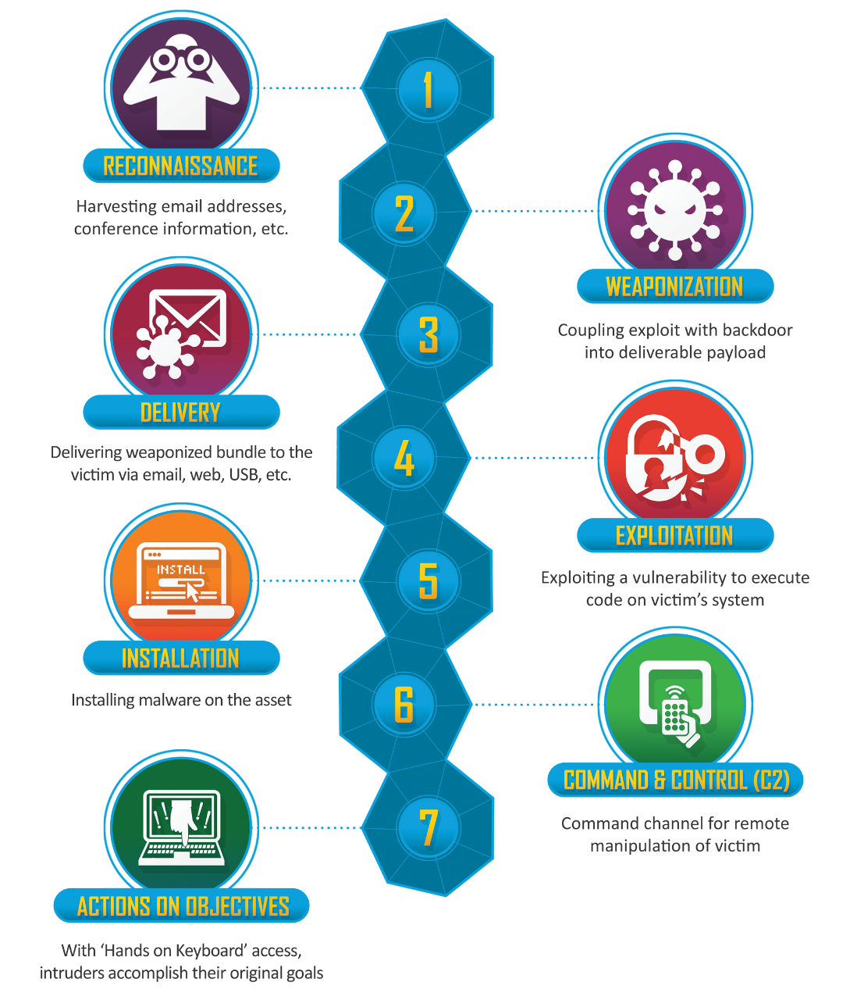
Cyber Kill Chain
Developed by Lockheed Martin
Used to describe the intrusion in steps
Can be combined with diamond model for real intrusion analysis fun!
Can be “chained together”
Can get complex with too much room for interpretation!

Slide 51
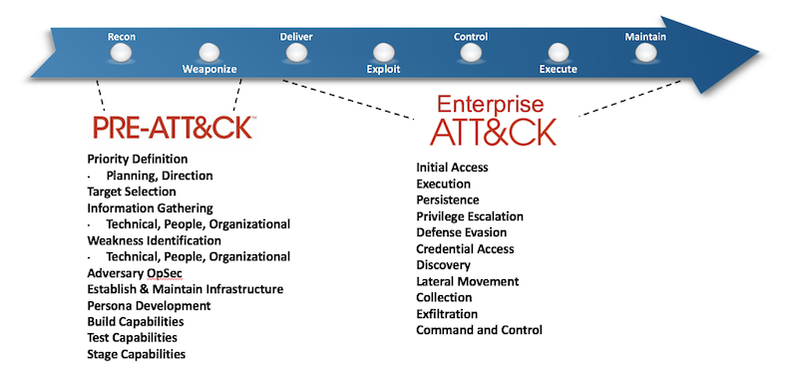
ATTACK Lifecycle

Slide 52
Phew – So that was the process
Lets try it out shall we?

Slide 53
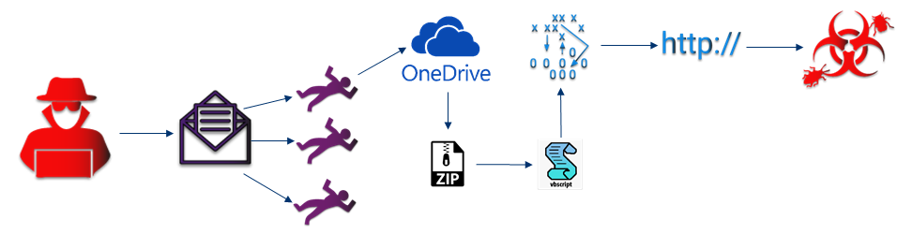
Example - Qbot early stages
A user recieves a mail reply as part of a previous mail correspondance with a friend. The new reply has a OneDrive link inside, they click on the link which retrieves a ZIP file to their machine. They unzip the file and it contains a file with a double extension, helpguide.docx.vbs. The file is shown by Windows to be a docx, so the user opens the file.

Slide 54
Example – Qbot early stages
The file was actually a VBS script, which when executed retrieved some information from WMI about the OS version, AV engine etc. It then attempted to retrieve, via BITS, second stage malware from 3 different domains, which all failed due to intelligence in the proxy filter.

Slide 55
Kill Chain mapping
Recon – Previous user mail compromise
Weaponization – Email
Delivery – Spearphishing link: onedrive.com/file/1234
Exploitation – User
Installation – Execution of docx.vbs: helpguide.docx.vbs
C2 – VBS (WMI, BITS): domain1.com, domain2.com, domain3.com
Actions on objectives – Retrieve second stage malware: Hash

Slide 56
So whats next??

Slide 57
Combining coa and cyber kill chain
 | Discover | Detect | Deny
Reconnaissance | - | - | -
Weaponization | - | - | -
Delivery (onedrive.com/file/1234) | Mail gateway logs, proxy logs | Mail gateway logs, proxy logs | Mail gateway
Exploitation (User - Spearphishing) | - | - | User awareness
Installation (helpguide.docx.vbs) | Host logs | AV alerts, host logs | AV (hash of docx)
C2 (domains) | Host logs, Proxy logs | Host logs, Intelligence alerts | Proxy filter, DNS Sinkholing
Actions on objectives (2nd stage) | Proxy logs (domains) | AV alerts, host logs (hash) | AV (hash)

Slide 58
Discover and preparation
 | Discover
Reconnaissance | -
Weaponization | -
Delivery (onedrive.com/file/1234) | Mail gateway logs, proxy logs
Exploitation (User - Spearphishing) | -
Installation (helpguide.docx.vbs) | Host logs
C2 (domains) | Host logs, Proxy logs
Actions on objectives (2nd stage) | Proxy logs (domains)
We’re probably going to need some logs……..

Slide 59
Detect and detection
 | Detect
Reconnaissance | -
Weaponization | -
Delivery (onedrive.com/file/1234) | Mail gateway logs, proxy logs
Exploitation (User - Spearphishing) | -
Installation (helpguide.docx.vbs) | AV alerts, host logs
C2 (domains) | Host logs, Intelligence alerts
Actions on objectives (2nd stage) | AV alerts, host logs (hash)
We’re definitely going to need some logs……..
Intelligence sharing…

Slide 60
Deny and Containment
 | Deny
Reconnaissance | -
Weaponization | -
Delivery (onedrive.com/file/1234) | Mail gateway
Exploitation (User - Spearphishing) | User awareness
Installation (helpguide.docx.vbs) | AV (hash of docx)
C2 (domains) | Proxy filter, DNS Sinkholing
Actions on objectives (2nd stage) | AV (hash)
Security tools
Proxy, DNS sinkholing, AV
User Awareness

Slide 61
Elastimispstash
Some great security guys have written an integration between ELK and MISP...
Enrichment on ingestion in real time...
Highly scalable...
Currently has support for ECS field types:-
Domain, ip and sha256

Slide 62
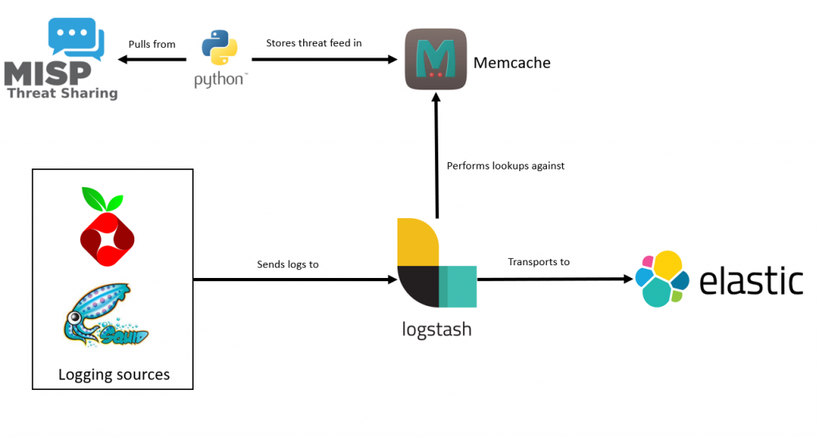
Elastimispstash

Slide 63
What do we need next time?
New indicators = New detections
Does my current awareness training work?
Do my security tools work?
Do I have the correct logs?
Is my log retention good enough?
Am I receiving good intel?

Slide 64
Further reading
https://www.securityweek.com/using-cyber-threat-intelligence-reduce-actors-opportunities
https://attack.mitre.org/
https://www.sans.org/reading-room/whitepapers/threats/creating-threat-profile-organization-35492
https://github.com/Neo23x0/sigma

